Slide 1


Status Report TTbar resonances Angular Distributions NTUA
George Bakas

Slide 2
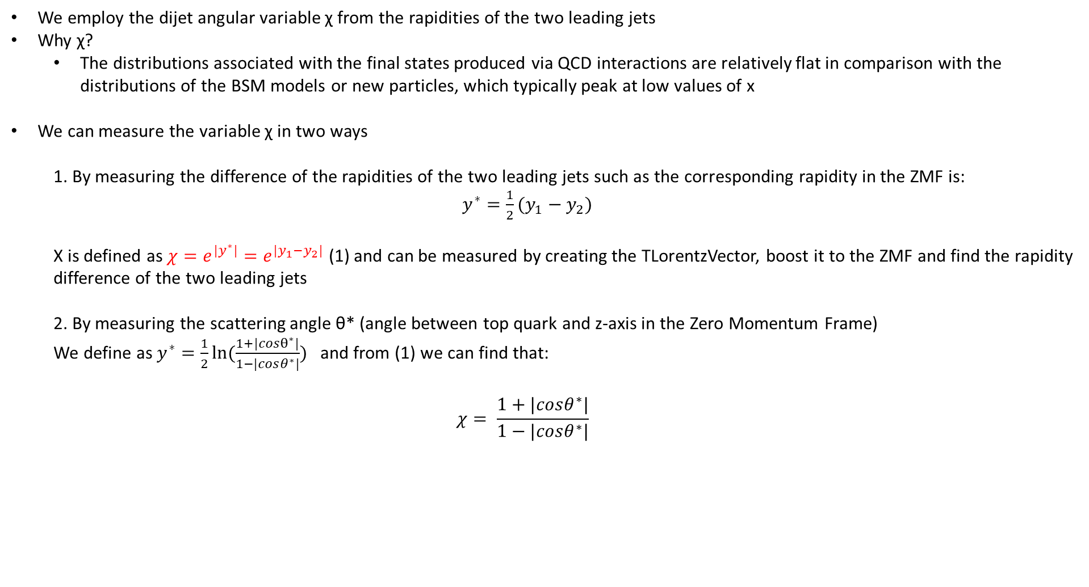
Variables
We employ the dijet angular variable χ from the rapidities of the two leading jets
Why χ?
The distributions associated with the final states produced via QCD interactions are relatively flat in comparison with the distributions of the BSM models or new particles, which typically peak at low values of x
We can measure the variable χ in two ways
1. By measuring the difference of the rapidities of the two leading jets such as the corresponding rapidity in the ZMF is: $y^{∗}=\frac{1}{2}(y_{1}−y_{2})$
Χ is defined as $χ=e^{{|y}^{∗}|}=e^{|y_{1}−y_{2}|}$ (1) and can be measured by creating the TLorentzVector, boost it to the ZMF and find the rapidity difference of the two leading jets
2. By measuring the scattering angle θ* (angle between top quark and z-axis in the Zero Momentum Frame)
We define as $y^{∗}=\frac{1}{2}ln⁡(\frac{1+|cosθ^{∗}|}{1−|cosθ^{∗}|})$ and from (1) we can find that:
$$χ= \frac{1+|cosθ^{∗}|}{1−|cosθ^{∗}|}$$

Slide 3
Response Matrices
Selection:
Parton: partonPt > 400, |partonEta|< 2.4, mTTbarParton > 1000
Reco: jetPt>400, |jetEta| < 2.4, nLeptons ==0
Btagging Medium working point
Top tagger mva > 0.3
Jet mass soft Drop (120, 220)GeV
Jets are matched
Response matrix of χ_{reco}, χ_{parton} with {1,2,3,4,5,6,8,10,13,16} as variable binning
The same binning is then used to find the response matrices in different mass (mTTbar) regions
[1000-1600]GeV
[1600-2200]GeV
[2200-3000]GeV
[3000-3600]GeV
[3600-6000]GeV
Stability, Efficiency for χ distribution
Acceptance and purity for χ

Slide 4
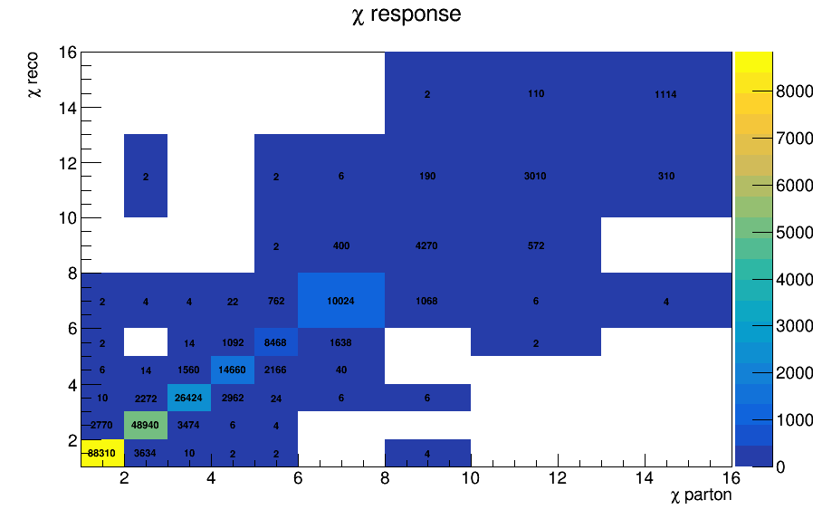
Response Matrix for χ distribution

Slide 5
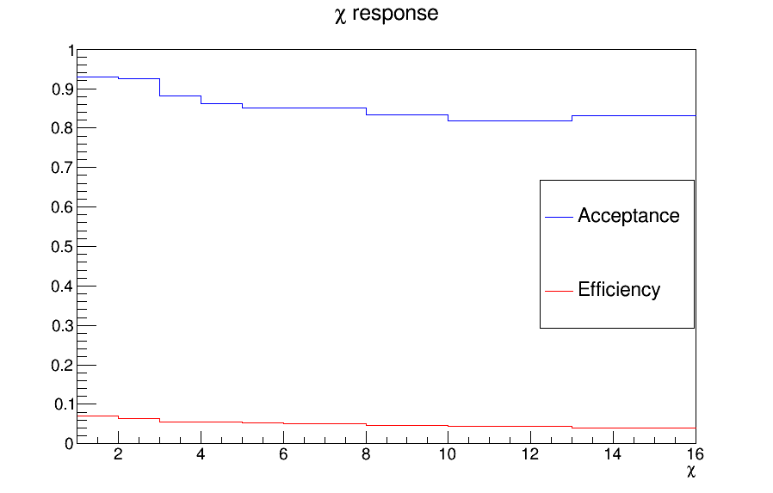
Efficiency and Acceptance

Slide 6
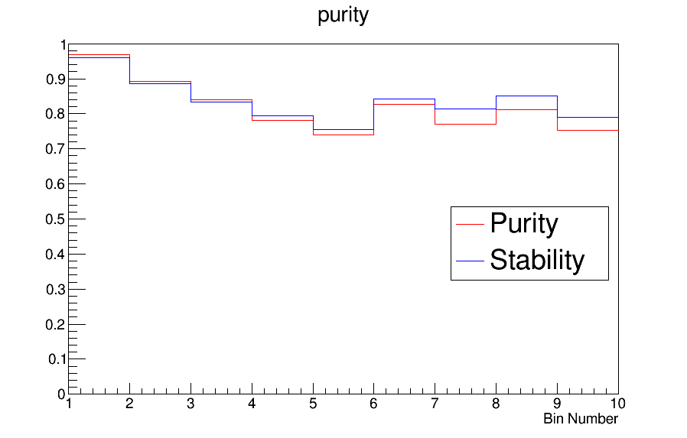
Purity and Stability

Slide 7
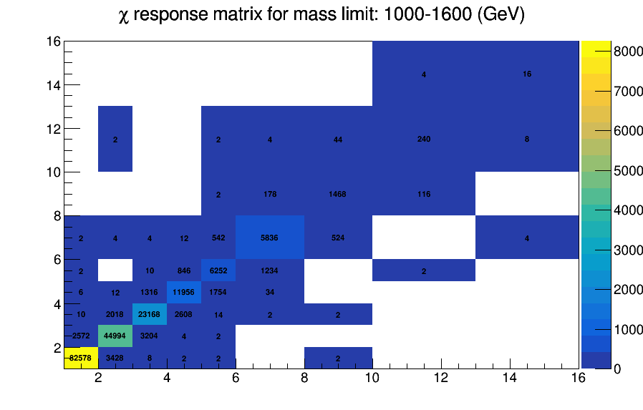
Response matrix for chi distribution in different mTTbar regions

Slide 8
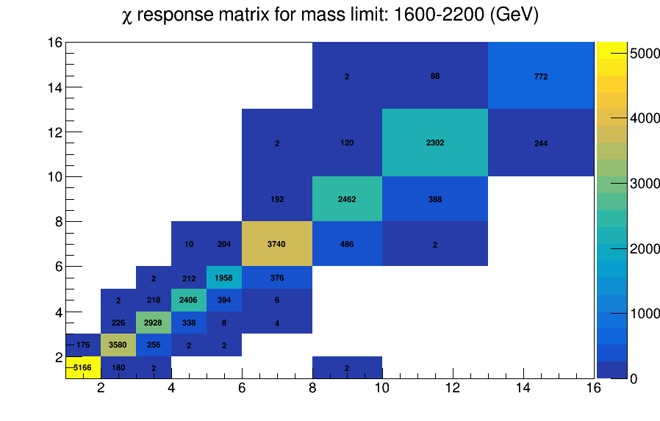
Response matrix for chi distribution in different mTTbar regions

Slide 9
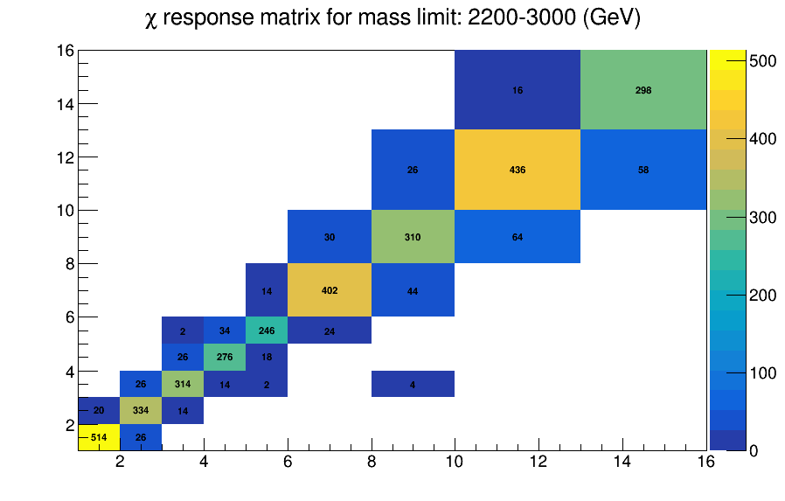
Response matrix for chi distribution in different mTTbar regions

Slide 10
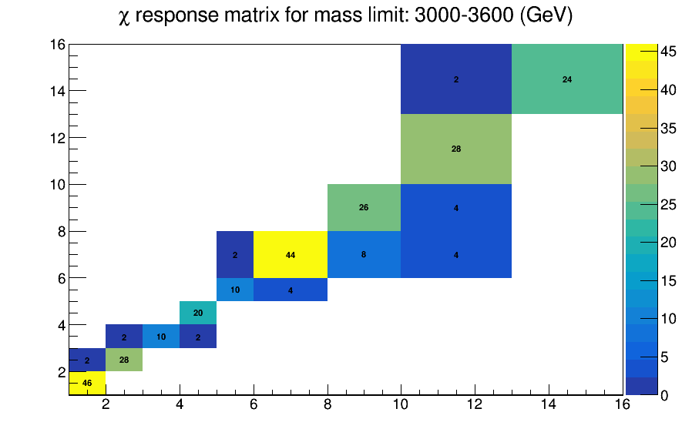
Response matrix for chi distribution in different mTTbar regions

Slide 11
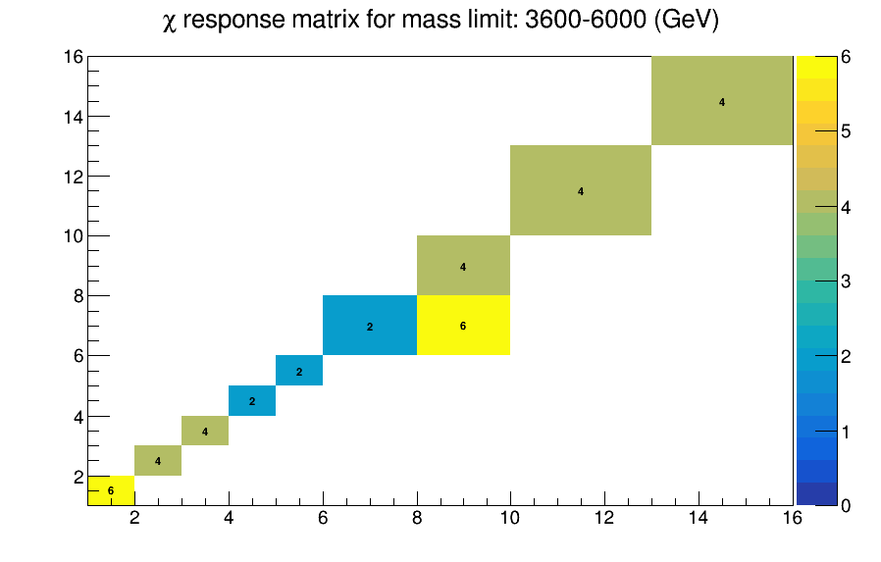
Response matrix for chi distribution in different mTTbar regions

